Slide 1

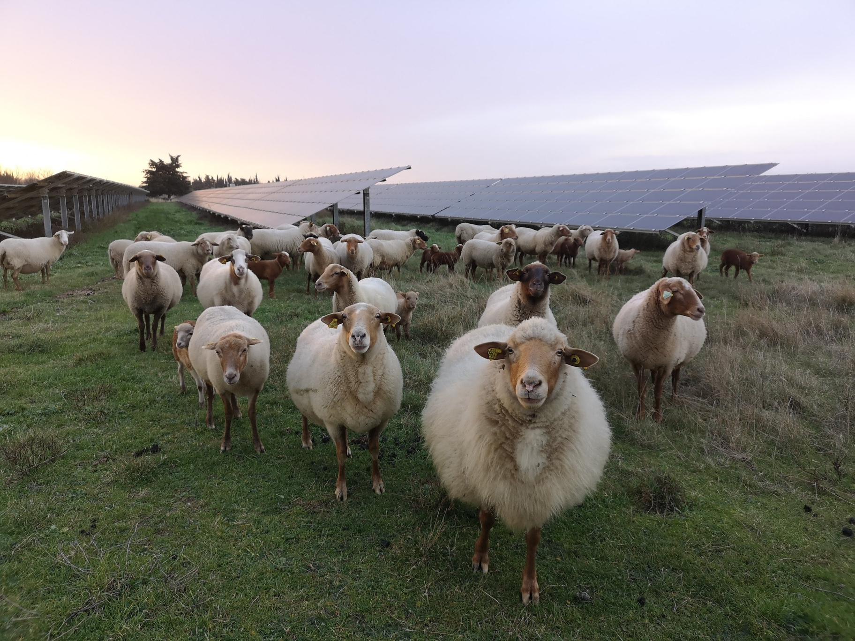
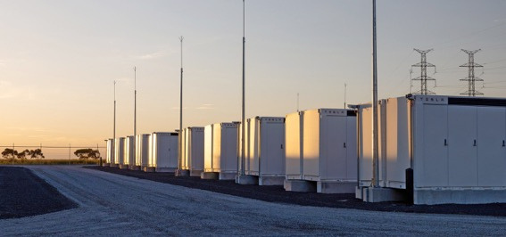
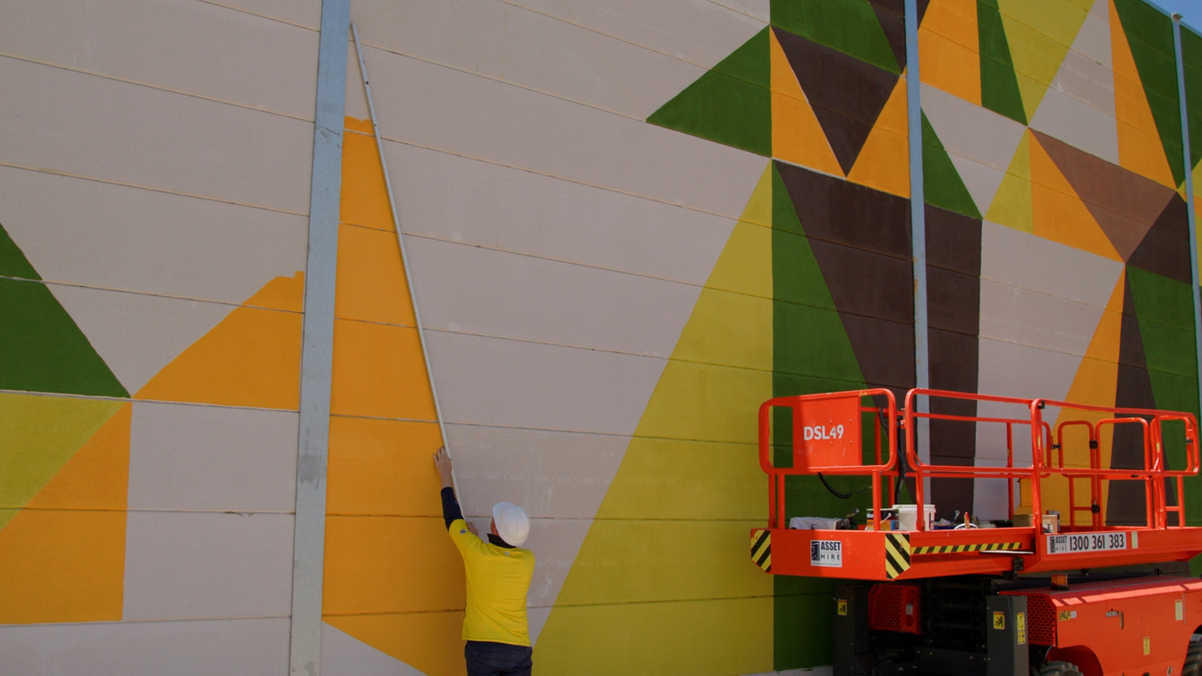
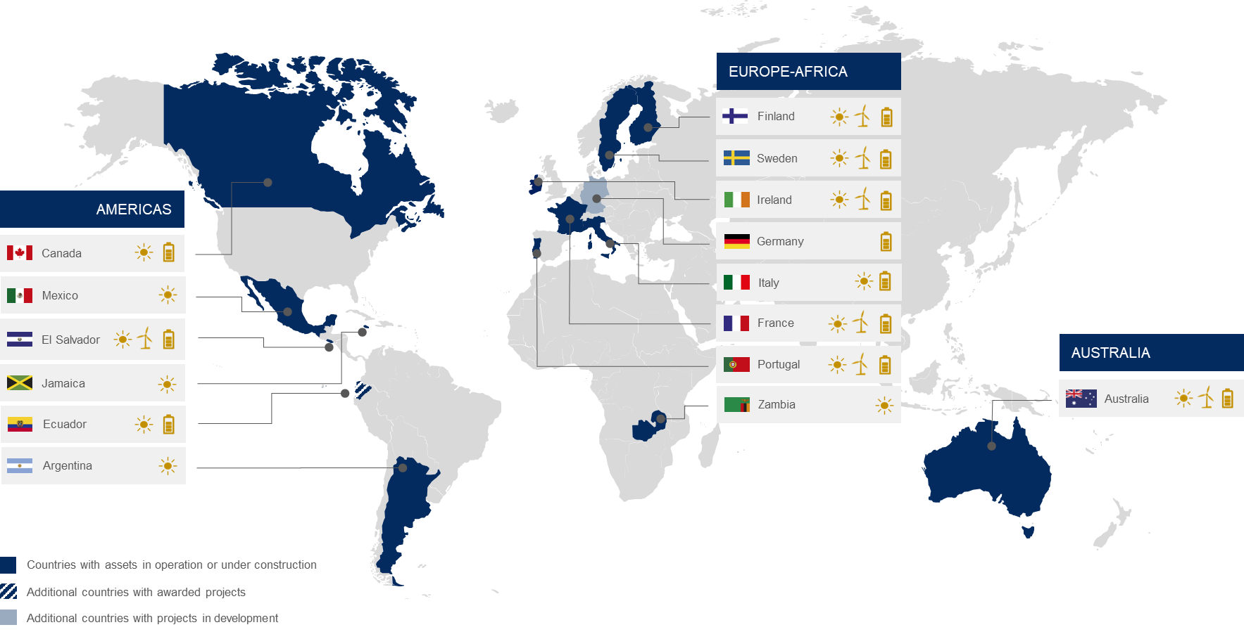
Neoen is a leading independent power producer of exclusively renewable energy, including solar and wind power, and battery energy storage.
We have a portfolio capacity of 8.7-gigawatts (GW) in operation or under construction across four continents. Our develop-to-own strategy means that we are around for the long-term.
Neoen has an active solar plant, Fox Coulee Solar Farm, in Starland County, Alberta, and several projects in development in Canada.

Slide 2
Project Background
  Sweetgrass Solar with Storage is a 315-megawatt alternating current (MWac) solar farm with a 150-megawatt (MW) capacity battery energy storage system (BESS) proposed for development on private lands located approximately 4.5-kilometres (km) east of the Hamlet of Granum between Township Roads 104 and 112, and Range Roads 260 and 262.
  Neoen’s application for Sweetgrass Solar with Storage was submitted to the Alberta Utilities Commission (AUC) for consideration in October 2024 and is subject to an AUC hearing (proceeding 29372) scheduled for April 28 - May 2, 2025.
  To connect the proposed Sweetgrass Solar with Storage project to the Alberta Interconnected Electric System (AIES), Neoen is proposing to construct up to approximately 17 km of new 240-kilovolt (kV) electrical transmission line that will connect to AltaLink’s existing 240kV line.
  The new transmission line is proposed to run between the Sweetgrass 1160S Substation and the Willow Creek 1132S Switching Station, where it will connect to AltaLink’s existing 240kV line.
  Three preliminary route options for the new transmission line have been identified for feedback.
  Following consultation, Neoen will submit at least two routes, one preferred and one alternate, to the AUC for consideration.

Slide 3
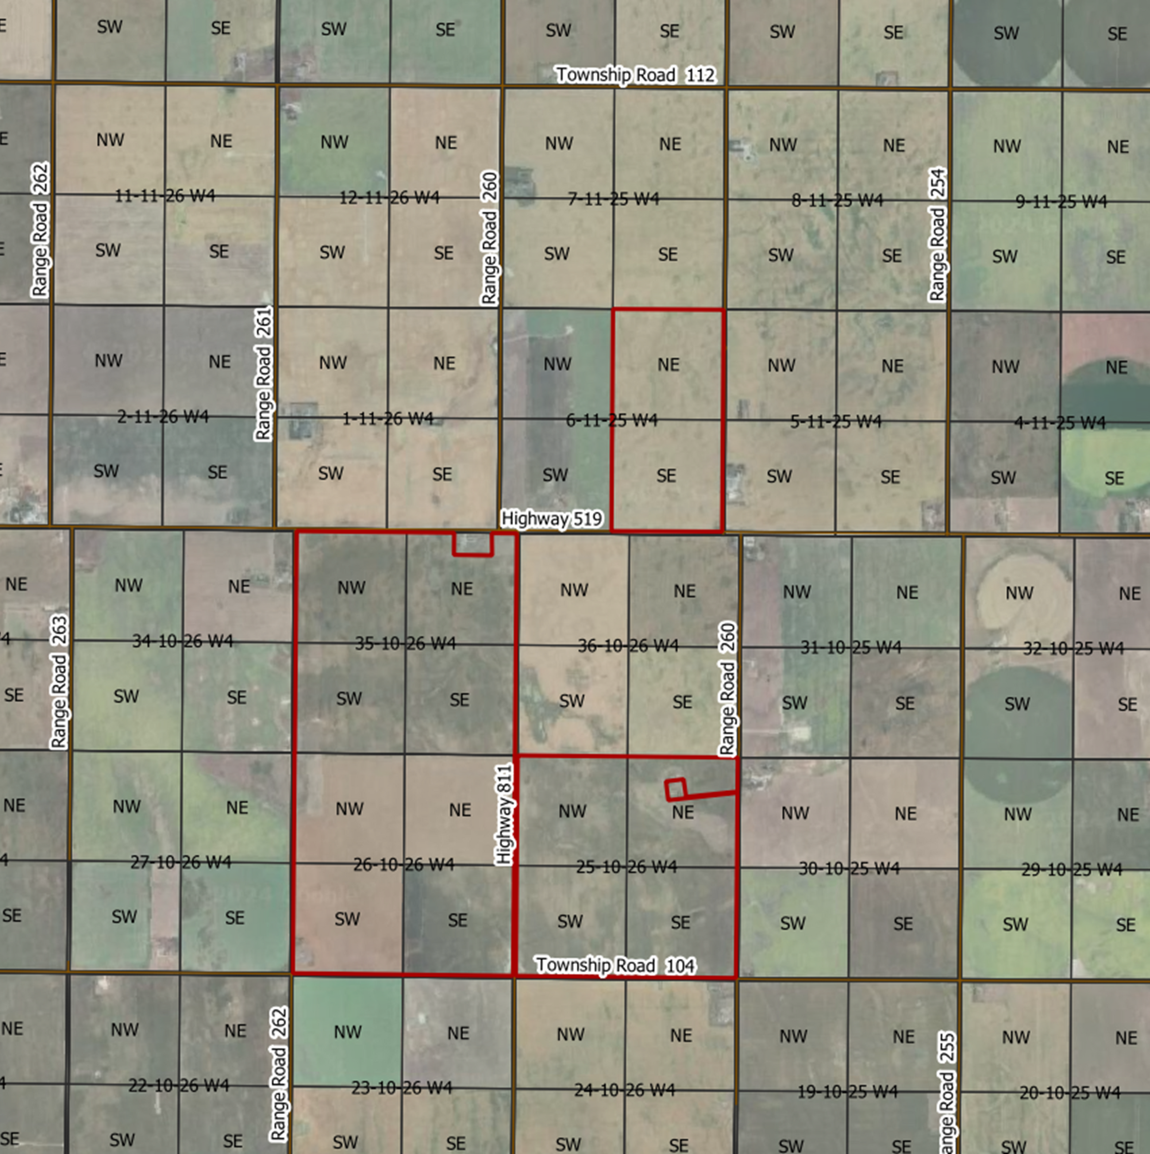
Sweetgrass Solar with Storage Project Lands

Slide 4

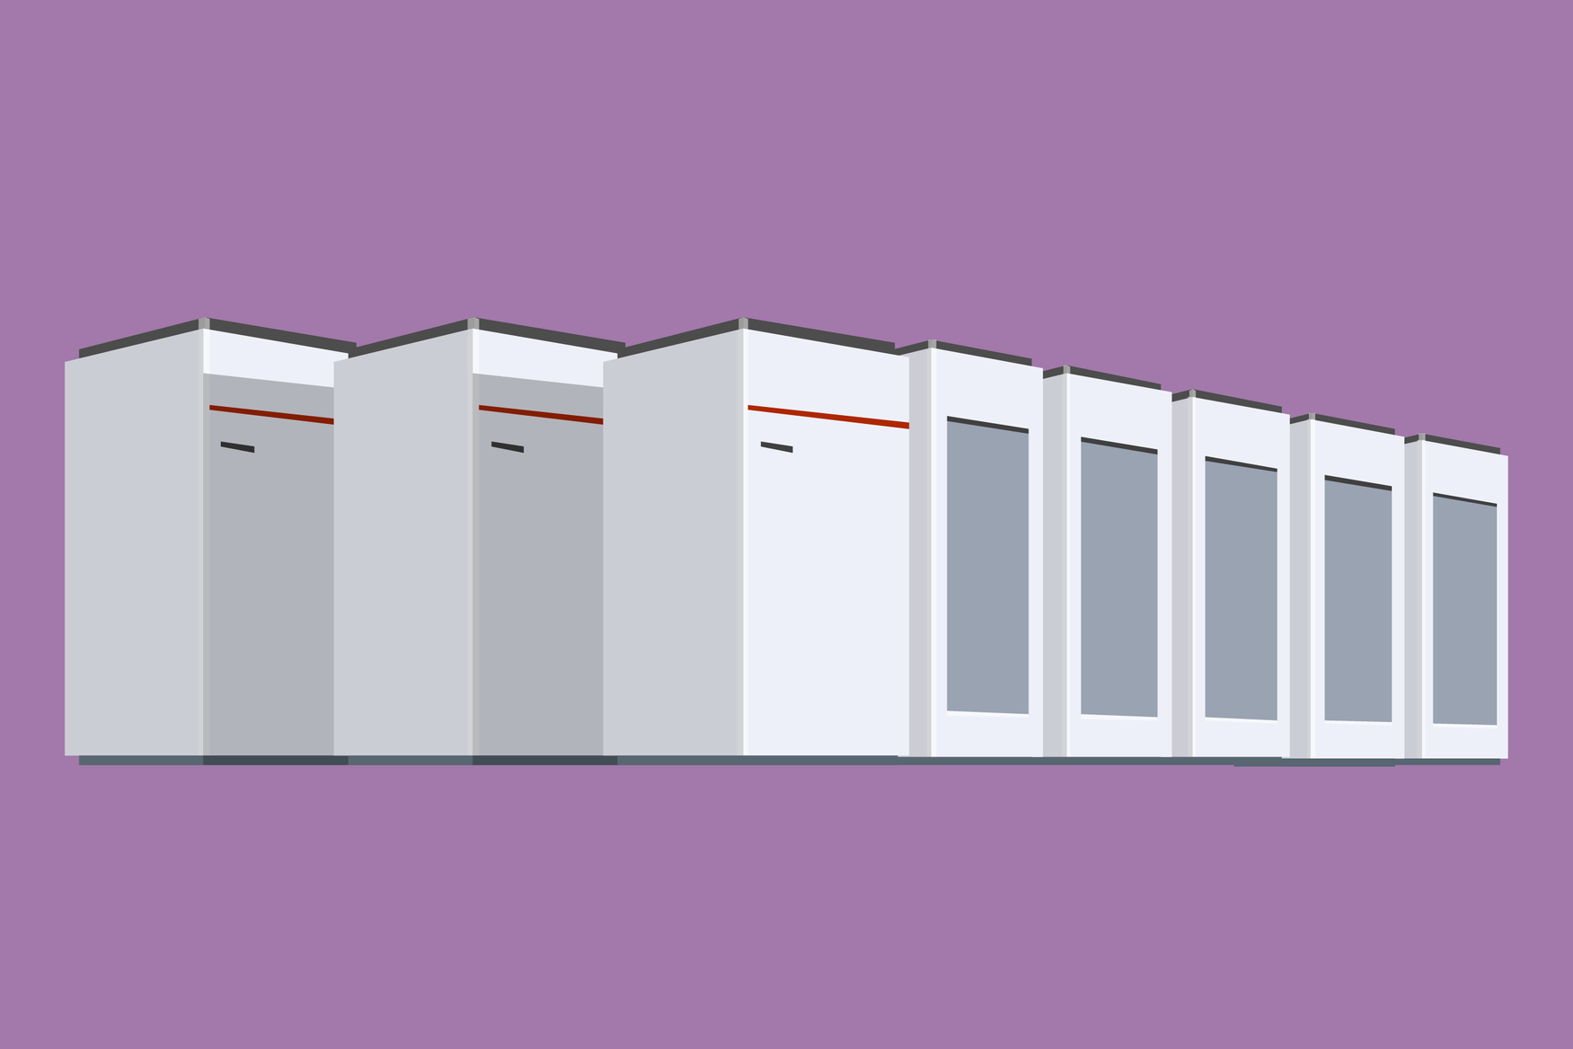
About Solar Power and Battery Energy Storage
  Bifacial, photovoltaic (PV) panels capture electromagnetic radiation from the sun and convert it into direct current (DC) electricity.
  PV panels are connected to inverters that convert DC to alternating current (AC).
  Transformers convert power generated by the PV panels from medium voltage (MV) to high voltage (HV) before discharging it to a power grid via transmission lines.
  Solar plants generate power when the sun is shining, and can standalone or be accompanied by a BESS.
  A Battery Energy Storage System (BESS) stores (or “charges”) electricity in batteries and later discharges it to an electrical grid.
  Typically, BESS charge when demand is low and discharge when demand rises.
  A BESS can standalone or accompany a renewable technology, like wind or solar power.
  In addition to energy storage, BESS provide critical grid reliability support, including ancillary services such as frequency and voltage support, black start, and virtual inertia.

Slide 5
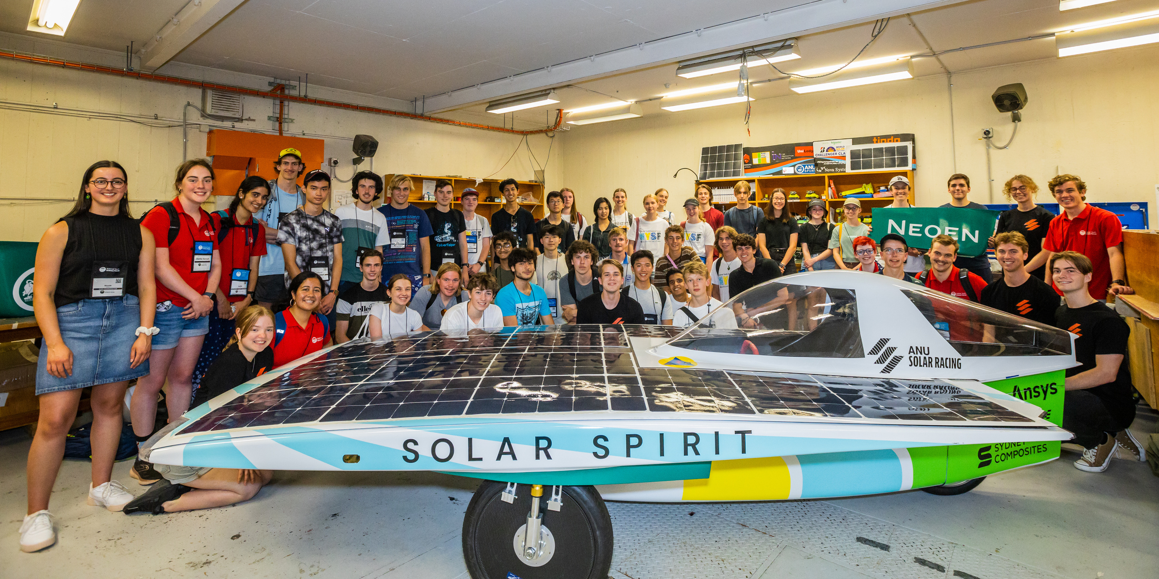
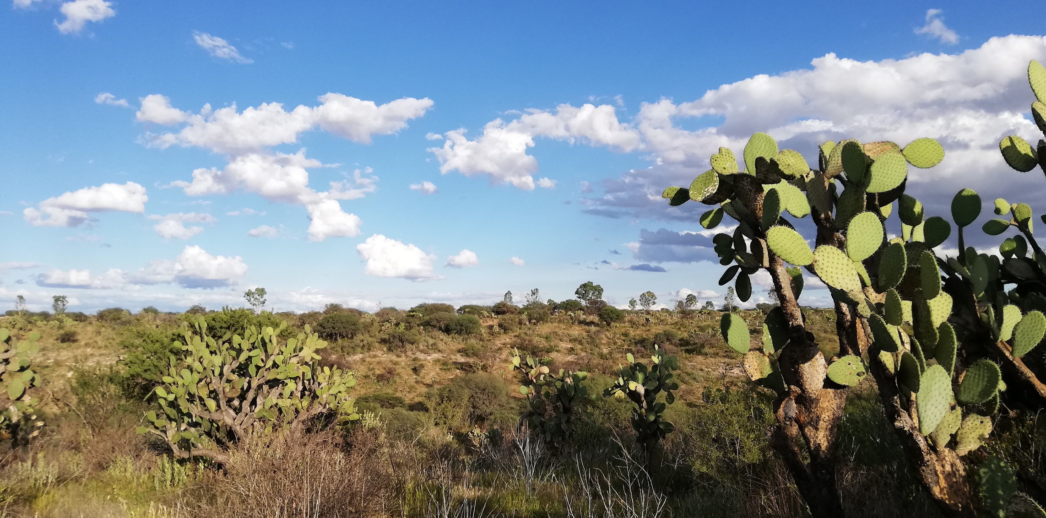
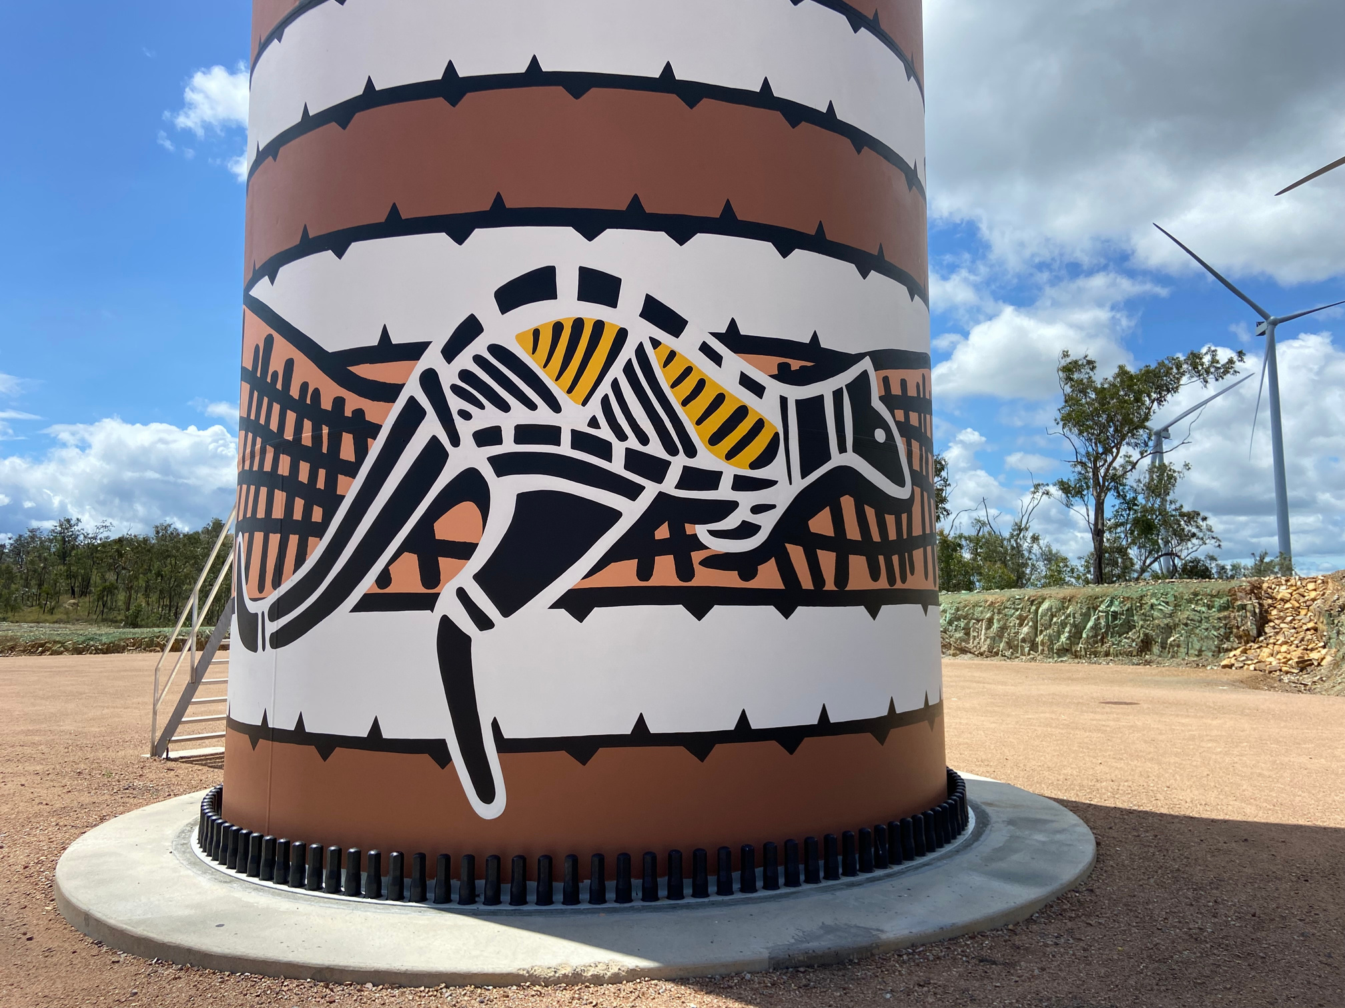
Community Benefits
  Neoen believes its projects should benefit the communities that host them.
  Community benefits for Sweetgrass Solar with Storage, including the transmission project, will include:
    Local job and spending opportunities.
    A community benefits fund to support clean energy, biodiversity, environmental, Indigenous-specific, cultural, social and/or educational initiatives.
    A local art initiative.
  Community benefits for Sweetgrass Solar with Storage will come into effect at operations.

Slide 6
Route Selection Process
  Neoen has identified three preliminary route options to connect the Sweetgrass Solar with Storage project to the Alberta Interconnected Electric System (AIES).
  Through consultation, Neoen will identify and propose at least two routes, one preferred and one alternate, which will be filed with the AUC as part of Neoen’s Facilities Application.
  Consultation, environmental findings and other factors may result in changes to the preliminary routes.
  The AUC will only approve (with or without conditions) one of the proposed routes and deny the other(s), or may deny all the proposed routes.
  AltaLink will conduct stakeholder engagement and environmental assessment for modifications to its existing 1038L transmission line and for the proposed Willow Creek 1132S switching substation.
  After commissioning, ownership of the new transmission line will be transferred to AltaLink.

Slide 7
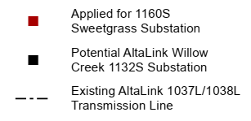

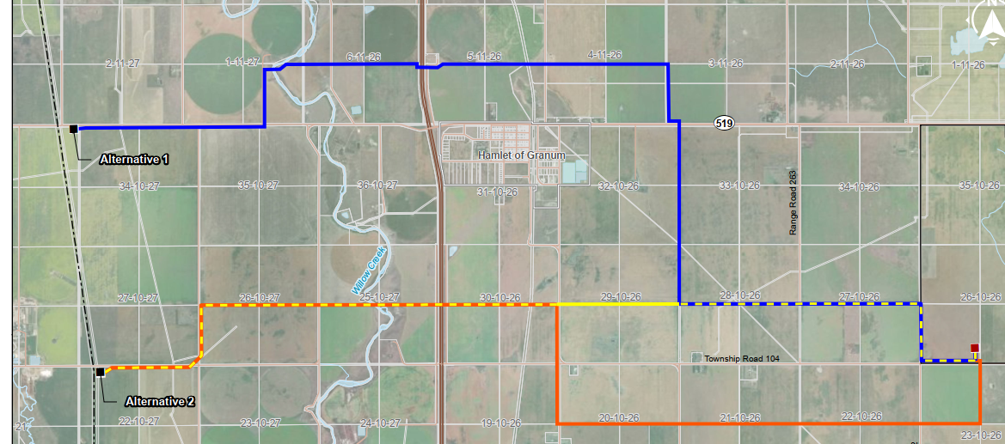
Preliminary Route Options
Routes are preliminary and are subject to change prior to submission to the AUC.

Slide 8
Sweetgrass Transmission Project Details
  Neoen is proposing to construct a new, single circuit, 240 kV transmission line up to approximately 17 km in length.
  The new line will run overhead and will be supported by steel or wood transmission structures erected approximately every 200-metres (m) along the selected route.
  Special structures may be required at corners, highway crossings, pipelines, or rivers.
  Structures may be erected within the road allowance or on private property depending on the outcome of consultation and existing infrastructure.
  Ground anchors may be installed to support transmission structures.
  The Sweetgrass Transmission project will be designed in accordance with the CSA, AESO, and AltaLink standards and regulations.

Slide 9
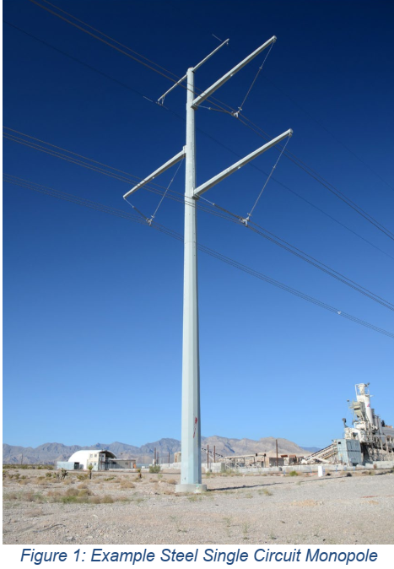
Typical Transmission Structures
  Steel structures are approximately 20 m in height and require approximately 30 m of right-of-way, excluding ground anchors (see Figure 1).
  Wood structures are approximately 24 m in height and require approximately 40 m of right-of-way, excluding ground anchors.

Slide 10
Environmental Assessment
  An Environmental Evaluation and Environmental Protection Plan will be completed to assess potential impacts to the environment resulting from the Sweetgrass Transmission project.
  Environmental factors such as soil classification, vegetation species and communities, wetland and watercourse delineation and classification, aquatic species, and historical resources will be considered in route selection.
  Where necessary, measures will be identified to mitigate potential impacts.
  A summary of the Environmental Evaluation and Environmental Protection Plan will be submitted to Alberta Environment and Protected Areas (AEPA) for review and feedback prior to submission of Neoen’s Facilities Application to the AUC.

Slide 11
Land Acquisition
  Neoen will acquire rights to install transmission structures required on private land in the form of utility right-of-way (ROW) agreements.
  Additional land may be acquired for temporary uses, such as laydown areas and construction access.
  If negotiations with landowners are unsuccessful, following receipt of a permit and licence from AUC (subject to project approval), land rights may be obtained through the Land and Property Rights Tribunal.
  Land acquisition will begin once and if the Sweetgrass Transmission project is approved by and receives a permit and licence from the AUC.

Slide 12
Transmission Construction
  Construction of the new transmission line and structures is expected to take approximately 12-18 months to complete.
  Construction will be undertaken by a contractor selected by Neoen.
  Construction activities may include:
    Equipment mobilization
    Clearing and grubbing of vegetation within ROW and in temporary work spaces (TWS)
    Topsoil removal, where required, to facilitate site access
    Transmission structure foundation installation (concrete or piles)
    Transmission structure framing and erection
    Conductor stringing
    Commissioning and testing
    Final landscaping and clean-up works

Slide 13
Project Timeline*
Q1 - Q2 2025
NOTICE OF PROJECT
PUBLIC CONSULTATION
ENVIRONMENTAL ASSESSMENT
ROUTE IDENTIFICATION COMMUNICATION
Q4 2025
SUBMISSION OF AUC FACILITIES APPLICATION
Q1 2027
CONSTRUCTION
Q2 2028
This timeline is approximate and subject to change*
OPERATIONS (30+ YEARS)

Slide 14
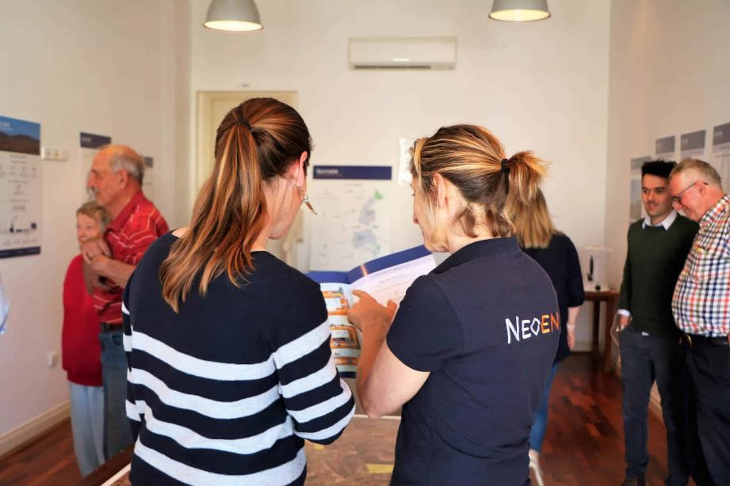
Public Consultation
  Consultation for the Sweetgrass Transmission project is underway.
  Neoen is consulting landowners and occupants directly adjacent the preliminary route options as well as stakeholders and Indigenous communities.
  Feedback gathered during the consultation period will inform at least two routes that will be submitted to the AUC as part of Neoen’s AUC Facilities Application.
  The proposed routes will be communicated via public notice to properties within the notification radius.
We want to hear from you!
  Phone: (587) 434-7547
  Email: sbrown@sabrenergyconsulting.com
  Mail: Box 3, Suite 530, 150 9th Avenue SW, Calgary, AB T2P 3H9
  Request a 1-on-1 meeting

Slide 15
SWEETGRASS TRANSMISSION PROJECT OPEN HOUSE

